Slide 1


Now What Do I Do? Navigating Moral and Ethical Dilemmas as Educators
Notes:
1

Slide 2

Today’s Objectives:
Understand the need and uses of the Model Code of Ethics for Educators (MCEE)
Apply new ethical understandings to practice
Notes:
2

Slide 3

The Need
Notes:
3

Slide 4
Imagine a profession…
… in which there is NOT a code of ethics to guide
professional decision-making
… in which the policies, statutes, and regulations that govern practitioners’ conduct are NOT even known by the practitioners
Would you call it a profession?

Slide 5
and what if that profession’s practitioners…
… make numerous decisions in a day that directly impact a highly vulnerable population; yet, have NEVER been prepared in ethical decision-making
… are NOT aware of the professional risks and vulnerabilities that are inherent in the profession; yet, they are expected to address the academic, personal, and social needs of 100’s of individuals a day
… have in loco parentis responsibilities; yet NEVER received training in supervisory liability

Slide 6
Would you call it a
profession?
and so it has been with education …

Slide 7
Professional Codes of Ethics
1847
American Medical Association
American Bar Association
American Psychological Association
American Counseling Association
Financial fiduciaries, law enforcement agencies,
and many others …
1932
1952
1961

Slide 8
Why Professional Ethical Standards?
Clarify to current and future teachers, and to those they serve, the nature of the ethical responsibilities held in common by all educators
Establish principles that define ethical behavior and ethical best practice
Serve as an ethical guide designed to assist educators in constructing the best course of action
Serve as a basis for educator learning, accountability, and remediation

Slide 9
Prompt, Guide, and Inform
“Awareness of the ethics codes is crucial to competence in the area of ethics, but the formal standards are not a substitute for an active deliberative, and creative approach to fulfilling our ethical responsibilities. They prompt, guide, and inform our ethical consideration; they do not serve as a substitute for it. There is no way that the codes and principles can be effectively followed or applied in a rote, thoughtless manner… each situation is unique and is likely to change significantly over time.”
Pope, K. & Vasquez M. (2011). Ethics in psychotherapy and counseling (4th edition).

Slide 10
Code of Conduct:
Policies, statutes, and/or judicial activity that articulate conduct absolutes at the following levels: employment, licensure, and criminal.
Code of Ethics:
Professional ethical standards that assist practitioners in choosing the best course-of-action.
www.nasdtec.net

Slide 11


Difference Between a Code of Conduct and a Code of Ethics
Code of Conduct
Code of Ethics
www.nasdtec.net

Slide 12
The Journey
Notes:
12

Slide 13

A part of NASDTEC’s core mission is to exercise leadership in matters related to the preparation and certification of professional school personnel
NASDTEC has taken the lead in fostering communication regarding professional practices across jurisdictional lines to help ensure the safety of children in P-12 classrooms
Notes:
13

Slide 14
Communication Partners
American Association of Colleges of Teacher Education (AACTE)
American Federation of Teachers (AFT)
Association of Teacher Educators (ATE)
Council for Accreditation of Educator Preparation (CAEP)
Council of Chief State School Officers (CCSSO)
National Association of Elementary School Principals (NAESP)
National Association of Secondary School Principals (NASSP)
National Board of Professional Teaching Standards (NBPTS)
National Education Association (NEA)
National Network of State Teachers of the Year (NNSTOY)
Notes:
14

Slide 15
MCEE Task Force
Composition
Nominations Process
Invitations
Selection
Initial Meeting
Notes:
15

Slide 16
The MCEE consists of five principles that define ethical behavior, ethical best practice, and ethical responsibilities held in common by P-12 educators.
The MCEE principles broadly define critical dimensions of ethical practice expected of the professional educator.
Each principle is followed by performance indicators that more specifically define aspects within each principle.
Notes:
16

Slide 17
Unpacking the Principles
Notes:
17
Lee-Ann:
Underline the nouns
Circle the verbs
Discuss:
What is the “heart” of the principle?
2-3 skills that a teacher leader would need to be aware of in order to navigate the principle?
What roles do you see for teacher leaders in regard to this domain?

Slide 18
Principle I: Responsibility to the Profession
Principle II: Responsibility for Professional Competence
Principle III: Responsibility to Students
Principle IV: Responsibility to the School Community
Principle V: Responsible and Ethical Use of Technology
Notes:
18
Lee-Ann:
Underline the nouns
Circle the verbs
Discuss:
What is the “heart” of the principle?
2-3 skills that a teacher leader would need to be aware of in order to navigate the principle?
What roles do you see for teacher leaders in regard to this domain?

Slide 19
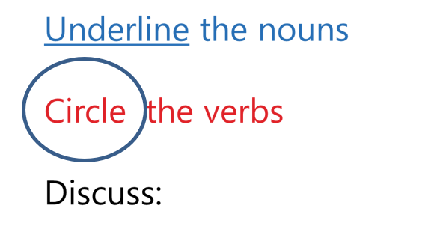
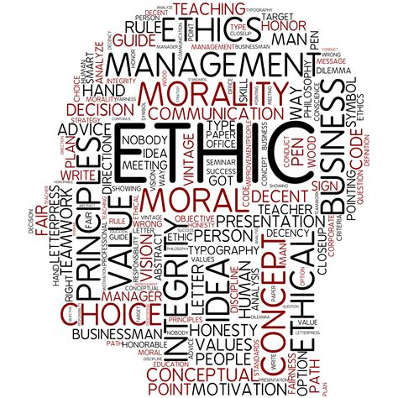
What is at the heart of this principle?
How might you use this to guide your practice?
How could you share this with trusted colleagues?
Notes:
19
Lee-Ann:
Underline the nouns
Circle the verbs
Discuss:
What is the “heart” of the principle?
2-3 skills that a teacher leader would need to be aware of in order to navigate the principle?
What roles do you see for teacher leaders in regard to this domain?

Slide 20
Applying the MCEE to an ethical dilemma
Notes:
20

Slide 21
A dilemma to ponder…
Mr. Smith is a 23 year-old high school English teacher and volleyball coach who has just finished his first year as a certified educator at Local High School.
In July of his summer break, he stops by his favorite coffee shop to enjoy a cup of fresh-brewed Sumatra. He runs into one of his former student-athletes, Julie, who is 19 years old.
They end up talking for several hours, and decide to meet the following day at the same coffee shop. They meet several more times that week, and mutually decide to commence a romantic dating relationship.
Source: Dr. Troy Hutchings
Notes:
21

Slide 22
A dilemma to ponder…
Mr. Smith is a 23 year-old high school English teacher and volleyball coach who has just finished his first year as a certified educator at Local High School.
In July of his summer break, he stops by his favorite coffee shop to enjoy a cup of fresh-brewed Sumatra. He runs into one of his former student-athletes, Julie, who is 19 years old.
They end up talking for several hours, and decide to meet the following day at the same coffee shop. They meet several more times that week, and mutually decide to commence a romantic dating relationship.
Source: Dr. Troy Hutchings
“Is this ethical?”
Notes:
22

Slide 23
Let’s throw in a few “ick” variables…
Mr. Smith is 45 years-old and Julie is 18
Mr. Smith is 45 and has a daughter Julie’s age
Mr. Smith knew that Julie had a crush on him all year
Julie was texting Mr. Smith during her senior year about personal problems
Or Perhaps…
Or Perhaps…
Or Perhaps…
Does this change the ethicality of the situation?
Source: Dr. Troy Hutchings
Notes:
23

Slide 24
“Is this ethical?”
Personal Morality
Defer to the Law
Right vs Wrong
Right vs Wrong
Good vs Evil
Good vs Evil
Us vs Them
Us vs Them
Personal Values
Is this even the right question?
Source: Dr. Troy Hutchings
Notes:
24

Slide 25
Let’s Reframe the Question…
Does their dating pose any risks to:
- his responsibility to students (past, present, and future)?
- his responsibility to the profession?
- his responsibility to himself?
… and that’s exactly what a code of ethics does
Source: Dr. Troy Hutchings
Notes:
25

Slide 26
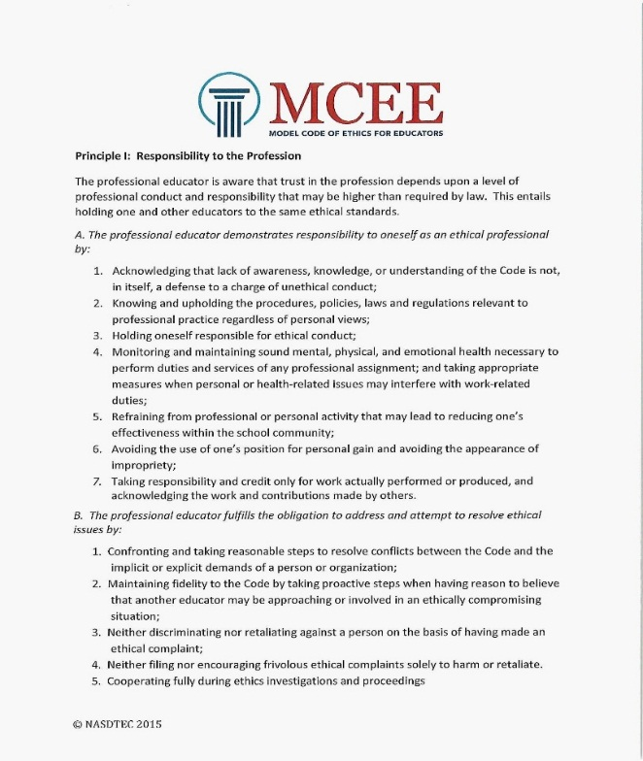
Applying the MCEE
Working with your elbow partner, use the MCEE to determine where within the code would you find guidance for this situation?

Slide 27
Model Code of Ethics for Educators
Principle III: Responsibility to Students
A (8): Acknowledging that there are no
circumstances that allow for educators to
engage in romantic or sexual relationships
with students.
A (9): Considering the ramifications of entering into an adult relationship of any kind with
a former student, including but not limited to,
an potential harm to the former student,
public perception, and the possible impact
on the teacher’s career. The professional
also ensures that the adult relationship
was not started while the former student
was in school.
Source: Dr. Troy Hutchings
?
5
1
2
3
4
Notes:
27

Slide 28
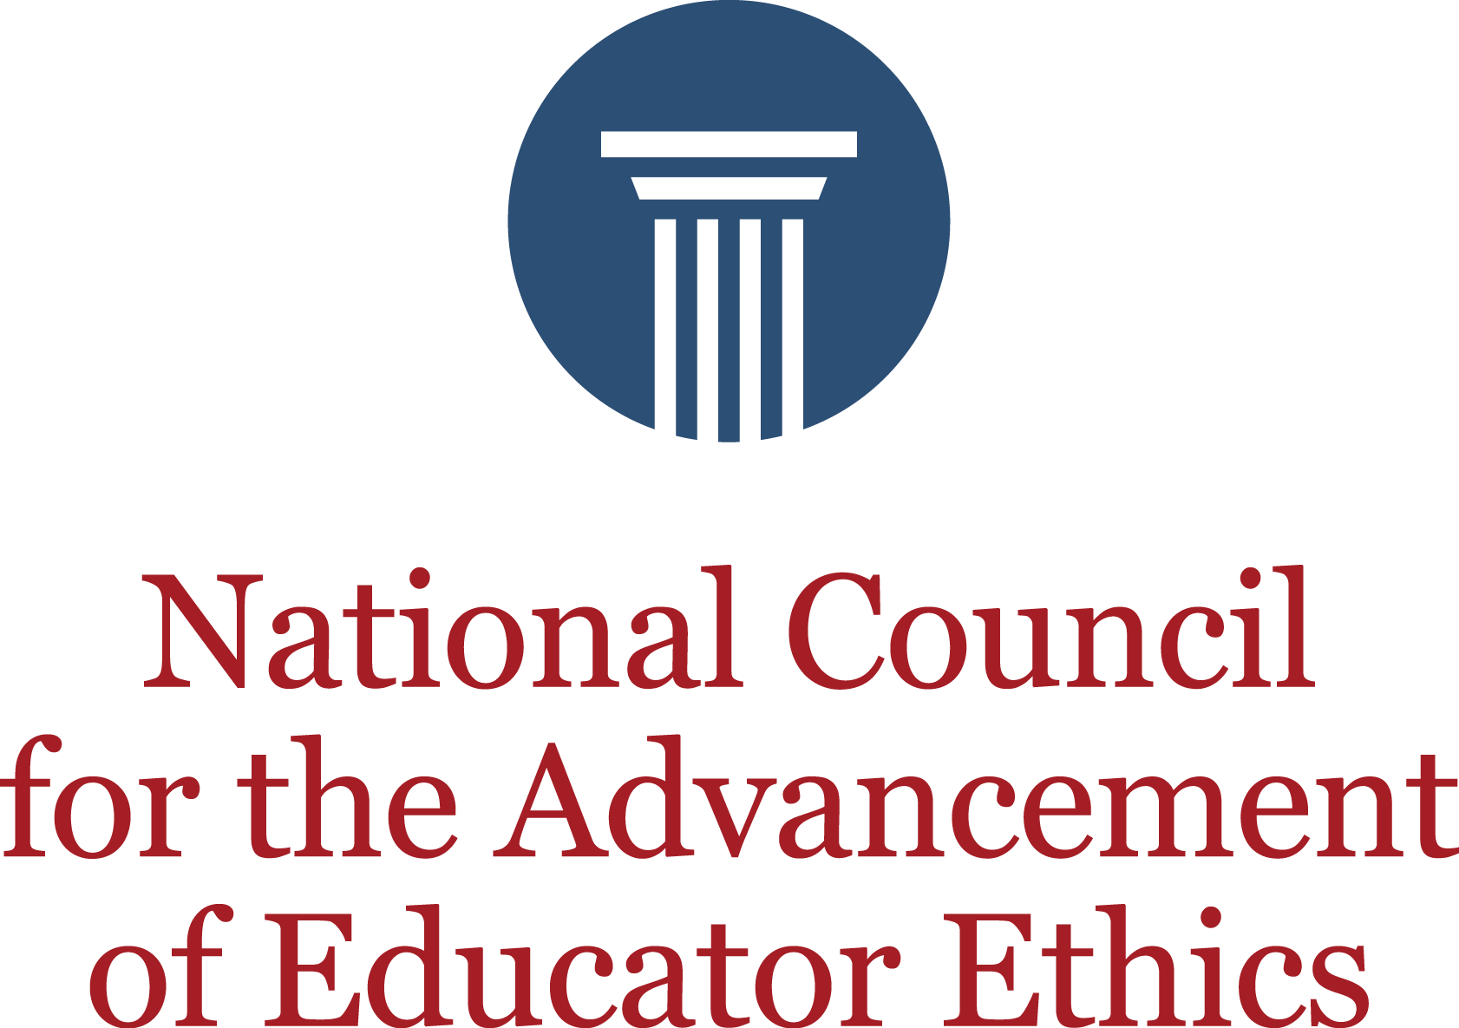
Why
… have Professional Ethical Standards?
“No profession can really exist without a code of ethics to guide the conduct of its members. Doctors, lawyers, and clergymen have their ethical codes, but teachers can scarcely be said to have such a code. Until they have developed a professional spirit which is characterized by loyalty to the recognized standards, they cannot rank with the learned professions” (Ontario Minster of Education, 1915).
Campbell, E. (2000). Professional ethics in teaching: toward the development of a code of practice. Cambridge Journal of Education, Vol. 30, No. 2.

Slide 29
Why
… have Professional Ethical Standards?
“No profession can really
22nd Annual Professional Practices Institute
Westin Harborview Hotel
Portland, Maine
October 17-19, 2018
www.nasdtec.net
kgbassett@outlook.com

