Slide 1
Assessing our Own Culture, Diversity, Equity and Bias
Emil Carafa, Heather Moran

Slide 2
What Does Equity Mean to You?
1. Brainstorm individually and silently for 1 minute - record as many words as you can that relate to your understanding of equity.
Talk with the people at your table to compare responses and determine the best two words that EVERYONE agrees upon.
3. Two people at table submit into Today’s Meet.
What does EQUITY mean to you?

Slide 3
What Should We Be Able to Do?
Effective leaders unearth their personal biases and how they link to core values and core beliefs
Effective leaders use what is unearthed to change grade levels, schools, district - creating equity norms
Effective leaders work to impact students & families in positive manner to improve outcomes for all

Slide 4
Norms and Agreements
1. Stay engaged.
2. Speak your truth.
3. Experience discomfort.
4. Expect and accept non-closure.
Taken from Courageous Conversations on Race by Glenn Singleton
Notes:
GG-
five minutes for norms
reasons why the norms are so important - as we developed the workshop it was uncomfortable at times based on personal experience both personal and professional with special emphasis on three and four; additional emphasis that these norms were specifically chosen for standards 3 and 10 - always include the topic when deciding on norms

Slide 5
Cultural Responsiveness
Let’s Get Vulnerable
Challenging Our Preset Practices
Making Learning Accessible to ALL
Notes:
GG-We must develop schema (background knowledge)
Cultural Responsiveness - causes us to address stakeholders diverse traditions and beliefs within educational contexts.
What will the facilitation language look like when using the car model. (We decided that for this first session we do not need to reference the CAR framework.)
http://www.edchange.org/handouts/Ten-Commitments.pdf
http://www.edchange.org/handouts/20things.pdf
http://www.edchange.org/handouts/Equity-Literacy-Introduction.pdf
How do we come back to the HOUSE activity after we venture into the bias, core values, core beliefs.
40 minutes

Slide 6
Influencers
Each person at the table needs a collection of 20 dots - color does not matter at all.
Number the dots 1 - 20 leaving room on each dot for a set of initials.
For each of the following prompts, record the initials of the FIRST person who comes to mind.
Notes:
GG-
Every person needs 20 dots - color is of no consequence. Ask them to number them 1 - 20 leaving room for a set of initials on them. When the slides flips to number 16, read each description aloud and have participants record initials of the first person that comes to mind - STRESS THE FIRST PERSON. After this is finished, presenters lower papers on each side of the room with following headings - Caucasian, African American, Hispanic/Latino, Asian, Pacific Islander, American Indian, More than One Race Have two sets of these in the room.
GG & RS-Use the balls to have volunteers discuss what the outcomes say to them. How did they feel? Were they surprised?
A Circle of Influence encompasses those concerns that we can do something about. They are concerns that we have some control over. Stephen Covey defines proactive as “being responsible for our own lives…..our behaviour is a function of our decisions, not our conditions. Proactive people focus on issues within their circle of influence. They work on things they can do something about. The nature of their energy in doing this is positive, enlarging and magnifying.

Slide 7
Influencers
doctor (any type, past or present)
partner/person you have had a dating relationship with (current or most recent)
neighbor (current or most recent)
best friend
college roommate
child or god-child (or other child you have close relationship with
favorite childhood teacher
favorite professor
favorite co-worker
spiritual leader (past or present)
favorite actor or actress
12. Star of the last movie you saw
13. author of the last book you read for pleasure
14. favorite food (ethnic group associated with it)
15. person who cuts/styles your hair
16. person you admire as a leader (past or present)
17. favorite athlete
18. favorite artist/performer
19. person in history you would like to meet
20. person who is a great role model
Notes:
GG-
Which do you have control over? What influences your choices?
Once everyone put the dots on the appropriate sheets--
Three stations (3 sheets)
Carousel
Who has a voice? (ball activity)

Slide 8
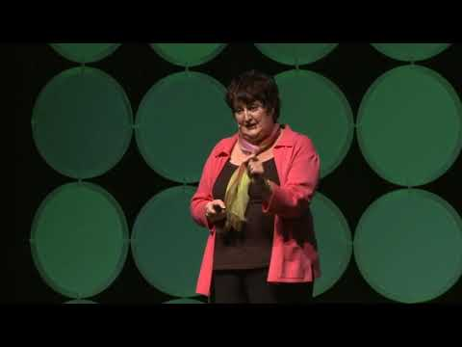

We All Have Blind Spots
Notes:
EC
Purposeful viewing sheet. - biological reason for a true blind spot; strupe effect; when does the imperceptible hesitation show up in the education frame? when does it exclude
AS we view the first video we need to reflect on ourselves about our blind-spot/s--- as we view the second video we must reflect on our own
Strupe effect as we work in our school communities.
20 minutes - break at 10:30
Question : Think about your beliefs that are important for student success and reflect on these statements as you watch these video clips.
How do our blind-spots and our brains need for congruency impact our staff, classrooms, students and district? How--(Turn & Talk few minutes writing on their own.
They belong in the classroom community
They can be successful in school
Their work in school is relevant to their lives

Slide 9
Moving You and Your Staff
Cultural responsiveness causes us to address stakeholders diverse traditions and beliefs within educational contexts. If we are unaware of our “blind spots” then that affects our ability to be culturally responsive which in turn affects equitable decision making for students and their families.
Notes:
EC
2 minutes to review slide

Slide 10

Moving You and Your Staff
Read each scenario. Determine how a lack of cultural responsiveness, especially as it relates to your blind spots, might be at work. What problems might occur as a result? Record on a post it and put it on the poster.
Notes:
RS
review directions

Slide 11
Moving You and Your Staff - Resources
Scenario #1 - What are the beliefs about equitable recruitment of female students into higher level science courses and science based clubs? (Few Women in Tech)
Scenario #2 - What are the beliefs related to language diversity and gifted education? Is that belief rooted in research? Whom does the sole criteria benefit as it relates to gifted education?
(Gifted Education)
Scenario #3 - Why does the system only value teacher recommendations and PARCC scores as selection criteria for Algebra?
(Minorities in Math) (Minorities in Math 2)
Scenario #4-What are the beliefs around safe spaces for LGBTQ students? What clubs and activities does this comprehensive high school value?
(LGBTQ Safe Spaces)
Scenario #5- Do potential beliefs and/or value systems contribute to discipline disparities amongst adminstration? If so, what are the potential belief systems of all three related to African American female students relating to the code of conduct?
(School Discipline Gap)
(School Discipline Gap 2)
Notes:
RS
Stop and write down one learning from the scenarios - stay at seats to discuss

Slide 12
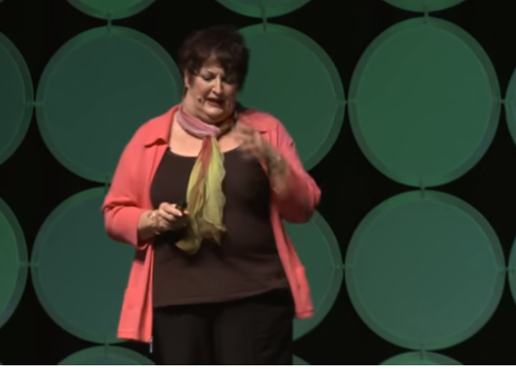
Unearthing Personal Bias
Notes:
EC
How does personal bias effect what we believe our classrooms, schools and school districts should look like? Use the balls to ask people to respond.
It is not the heroic actions of tackling complex societal problems that count; instead,
“the power of context says that what really matters is the little things.”
Fullan 2003

Slide 13
Norms and Agreements
1. Stay engaged.
2. Speak your truth.
3. Experience discomfort.
4. Expect and accept non-closure.
Taken from Courageous Conversations on Race by Glenn Singleton
Notes:
GG-
five minutes for norms
reasons why the norms are so important - as we developed the workshop it was uncomfortable at times based on personal experience both personal and professional with special emphasis on three and four; additional emphasis that these norms were specifically chosen for standards 3 and 10 - always include the topic when deciding on norms

Slide 14
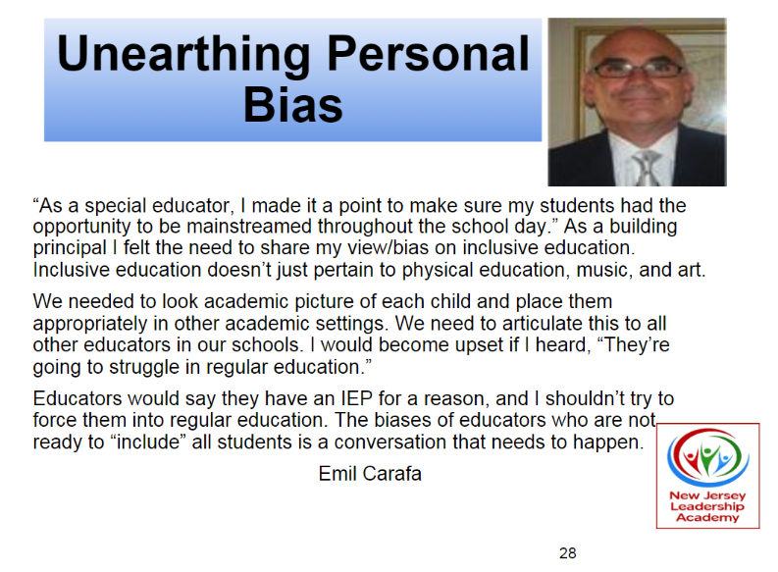



Slide 15
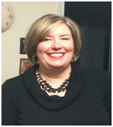
Unearthing Personal Bias
As a middle school principal, it is extremely important for me to balance the desire of my students to be more independent from their parents and the need for the support and involvement of my parent and community. It is also extremely important for me to value the input of all parents - not just those who are like minded. My personal bias has been dealing with parents who cannot get along with each other.
As a divorced parent who gets along with the father of my children, I get extremely aggravated when parents request separate mailings or conference times or phone calls. I hear myself getting agitated and dismissive as opposed to supportive and understanding.
Schools need to value all parents equally and be very happy when
they want information and attempt to be involved. It is our job to
facilitate that.
Notes:
Fill this out independently
Fill their toolbox --- Job alikes

Slide 16
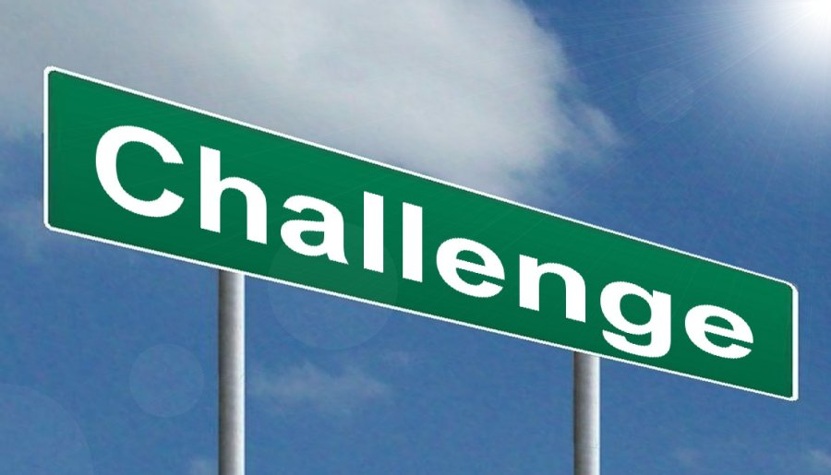
Looking at the personal bias just shared...
Find a partner.
What challenges would this present for student outcomes?
What opportunities would this present for student outcomes?
Notes:
KW & GG-
Job alike
Questions we want here to let them uncover how the personal bias impacts student achievement, hiring practices, day to day operations etc - is it a handout as well?
Participants will be separated into role alike groups by going to a different part of the room. They will find a partner with same job title. They will share answers to these questions with each other. To share out with the larger group, we will popcorn responses from a few pairs in each role alike hitting all categories of jobs in the room. Key is to see how same issue has different impact at different leadership levels.
Use the balls and the microphones to get responses from varied job alike groups starting with elementary, middle, high school, and central office

Slide 17
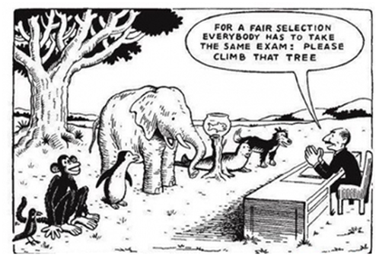
Notes:
RS & EC
Albert Einstein-”Everybody is a genius. But is you judge a fish by its ability to climb a tree, it will live its whole life believing that is is stupid.”

Slide 18

Conference Feedback Survey
A professional development certificate will be sent via email once you have completed a PD Feedback Survey for each workshop that you have attended.
Please be sure to complete a survey form at the end of each presentation.
The feedback form can be found at the following places
Learning Forward New Jersey Website
Learning Forward New Jersey FaceBook Page
Learning Forward New Jersey Twitter
Conference Feedback Survey Link
Notes:
Here is the link to our Facebook: https://www.facebook.com/LearningForwardNewJersey/?ref=br_rs
Here is the link to our website: https://nj.learningforward.org/
Here is the link to our conference on our website: https://nj.learningforward.org/event/learning-forward-new-jersey-annual-conference-2/

Slide 19
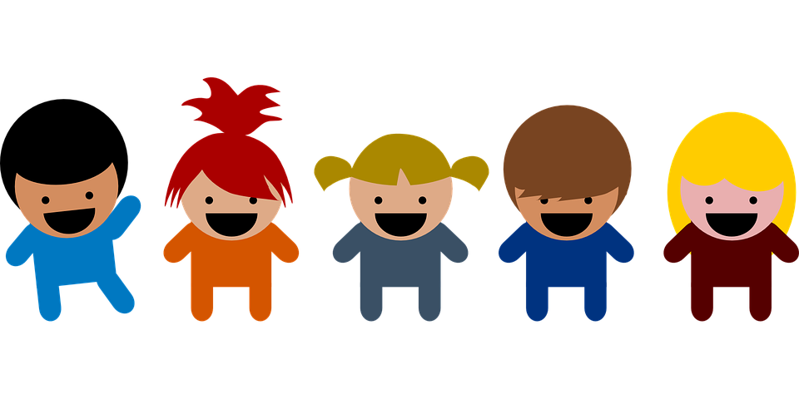
THANK YOU
Notes:
RS & EC

Slide 20

How Would You Title this Picture?
Notes:
RS & EC
In the context of our prior conversations how do you interpret this image?
This would be a great time to use the new ball to share ideas from the audience. Volunteers get microphone ball sent to them and share thoughts. Toss to next volunteer. GG has six balls and will distribute them around the room while he and RS use the microphones to record thoughts from the audience.

