Slide 1



Becoming a Learning Team
A guide to a teacher-led cycle of continuous improvement
THE PROFESSIONAL LEARNING ASSOCIATION
Learning Forward
New Jersey
August 3, 2018

Slide 2

Learning Forward’s beliefs
Professional learning that improves educator effectiveness is fundamental to student
learning.
More students achieve when educators assume collective responsibility for student learning.
All educators have an obligation to improve their practice.
www.learningforward.org
2

Slide 3

Learning Forward’s beliefs
Effective school systems commit to
continuous improvement for all adults and students.
Successful leaders create and sustain a culture of learning.
Diversity strengthens decisions..
www.learningforward.org
3

Slide 4

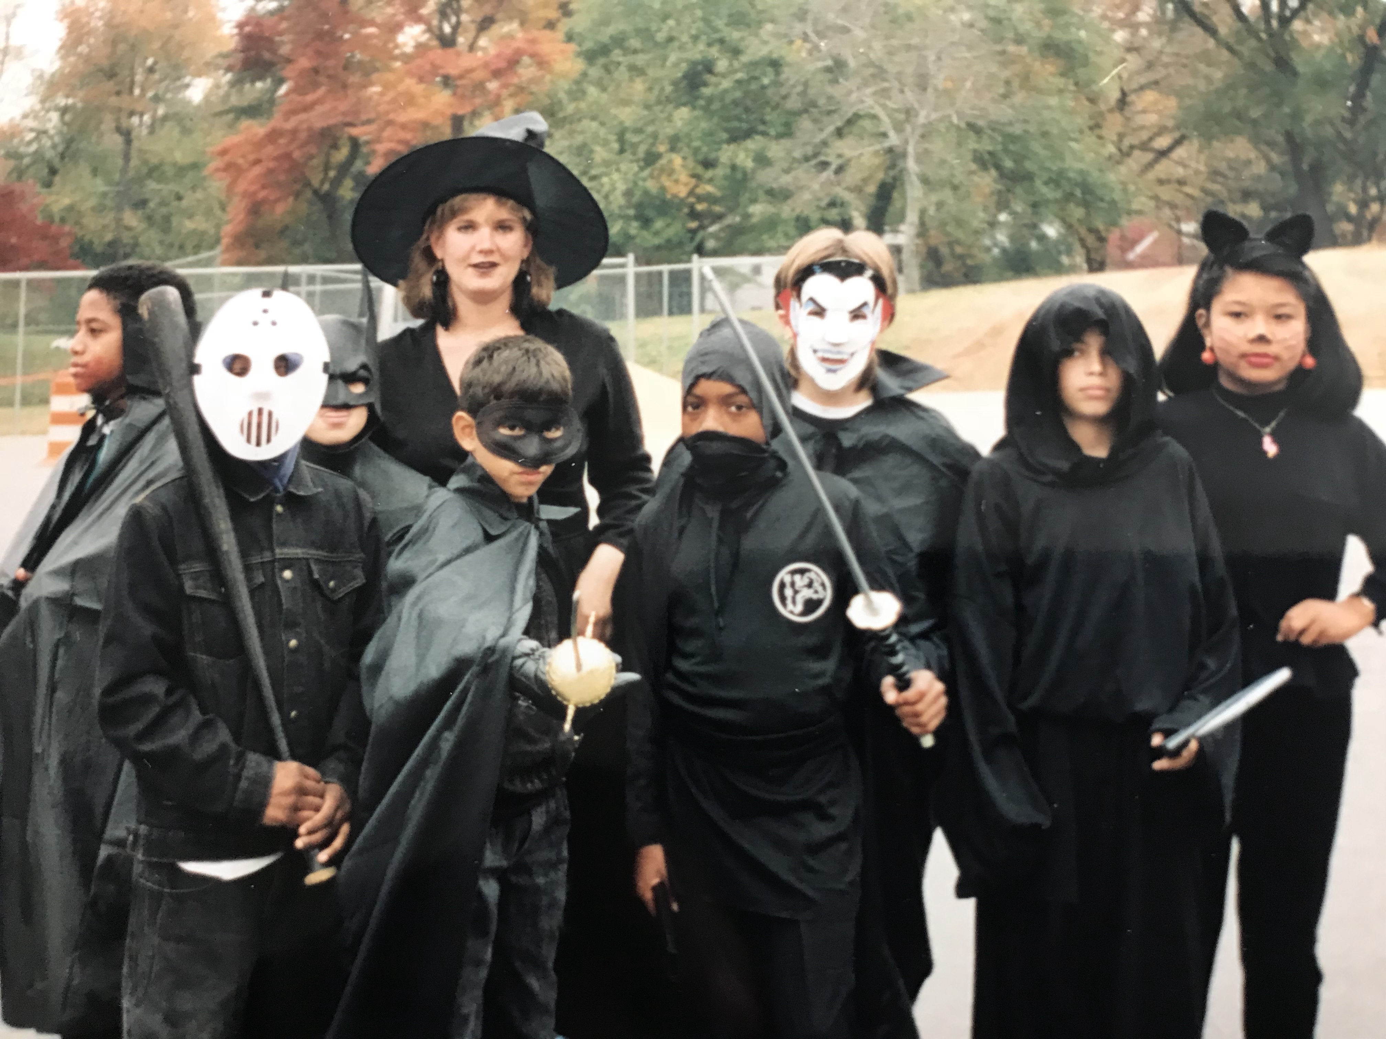

Picture from 1990

Slide 5
Today’s agenda
The case for teacher-led learning teams
Overview of the learning team cycle
Teacher teams in action in New Jersey
Conditions for successful implementation

Slide 6
Becoming a learning . . .
2nd Edition – Summer 18
Intersection between instructional materials and professional learning
Setting your learning agenda

Slide 7

Three Big Ideas
Teachers and leaders value a system of professional learning over sporadic instances of professional development.
Collaborative learning is at the heart of a system of continuous learning.
Teacher teams are intentional about their learning.

Slide 8
Who is this book for?
Teachers
Teacher leaders/coaches
Principals/school leaders
District/school professional learning leaders
External supporters/providers

Slide 9


Connect with your experience
When you hear the phrase “learning cycle,” what components come to mind?
What other learning cycle models are familiar to you?
Notes:
Cycle through on the chat responses- share twice and then move to the next presenter
Stephanie- “Thank you to everyone who shared” :)

Slide 10

Why learning teams?
“... teachers work together to develop plans, develop common understandings of what is worth teaching, collaborate on understanding their beliefs of challenge and progress, and evaluate the impact of their planning on student outcomes.”
— John Hattie
Visible Learning for Teachers (2012)

Slide 11
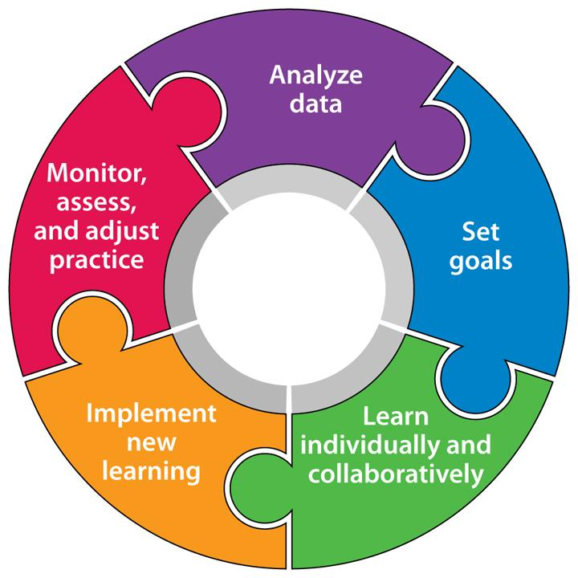
Overview of the teacher learning team cycle
Source: Becoming a Learning Team: A Guide to a Teacher-Led Cycle of Continuous Improvement

Slide 12
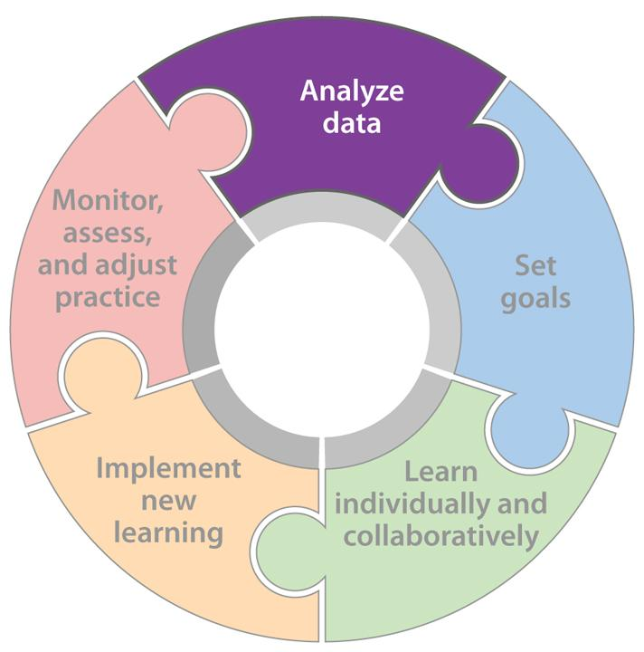
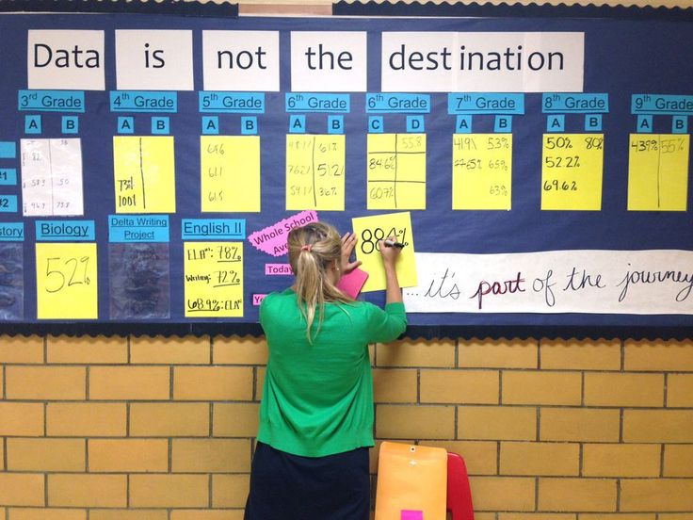
Analyze data
In this stage....
Teams examine student and educator learning challenges.
Notes:
In this first stage, teams are working to gather and analyze relevant data in order determine possible areas of focus.

Slide 13
Analyze data
Key actions
Identify and collect essential data
Examine student and educator learning challenges
Organize and display data for analysis
Examine data for trends, issues, and opportunities
Summarize the data
Notes:
John

Slide 14
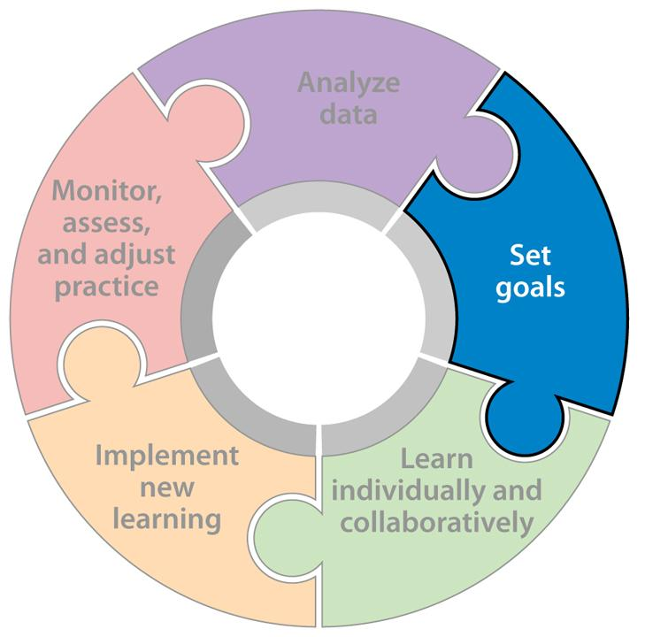

Set goals
In this stage....
Teams identify shared goals for student and educator learning.
Notes:
Stephanie

Slide 15
Set goals
Key actions
Review summary statements and set priorities
Identify shared goals for student and educator learning
Write student goals
Write educator goals
Review with others
Notes:
Stephanie

Slide 16
SMART for student learning goals
S | Specific (strategic, systemic, stretching)
What will students achieve?
M | Measurable
How will it be measured?
A | Attainable
Are the goals realistic for students?
R | Results-based
Are the goals oriented toward clear outcomes?
T | Time-bound
When will students be expected to demonstrate attainment of goals?
Notes:
Stephanie

Slide 17




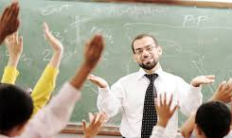
KASAB for teacher learning goals
Knowledge | Conceptual understanding of information, theories, principles, research
Attitude | Beliefs about the value of particular information or strategies
Skill | Strategies and processes to apply knowledge
Aspirations | Desires, or internal motivation, to engage in a particular practice
Behaviors | Consistent application of knowledge and skills
Notes:
Stephanie

Slide 18
Somers Point School District – Kimberly Tucker
Student-Centered Learning Goal
During the 2017-18 school year, all preschool students will show growth in academic skills as measured by the Student Growth Objective assessments. Research shows that by increasing parental involvement opportunities and improving the parents' view on their role in their child's education process, student achievement in school will also improve.
SMART format
Notes:
Stephanie

Slide 19
Somers Point Educator-Centered Learning Goals
Knowledge of the correlation between parental involvement and student achievement; knowledge of what types of parental involvement increase student achievement.
Attitude: Positive, supportive parental involvement is necessary for student success in preschool.
Skills: Research effective parenting skills and how to effectively deliver information to parents and caregivers.
Aspiration: By increasing parental involvement, students will show growth from beginning to end of year preschool assessments.
Behavior: The Pre-K Team will host one Family night, with an emphasis on how parents and caretakers can engage in activities that support their child's development. Evidence will be provided through parent sign-in sheets, photos, and parent feedback/evaluations. Parents will be invited to participate in classroom activities throughout the year. Parents will be invited to participate in the creation of a community butterfly garden and little lending library at the school.
KASAB format
Notes:
Stephanie

Slide 20
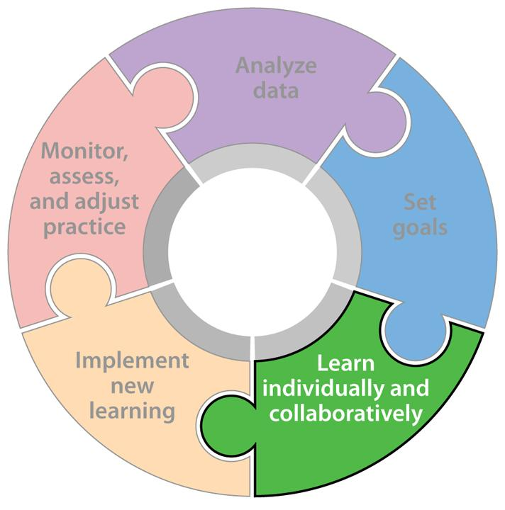

Learn individually and collaboratively
In this stage....
Teams gain new knowledge and skills; examine assumptions, aspirations, and beliefs.

Slide 21
Learn individually and collaboratively
Key actions
Review goals and clarify critical content
Gain new knowledge and skills; examine assumptions, aspirations, and beliefs
Write team and individual learning agendas
Schedule the learning
Engage in learning to inform application

Slide 22
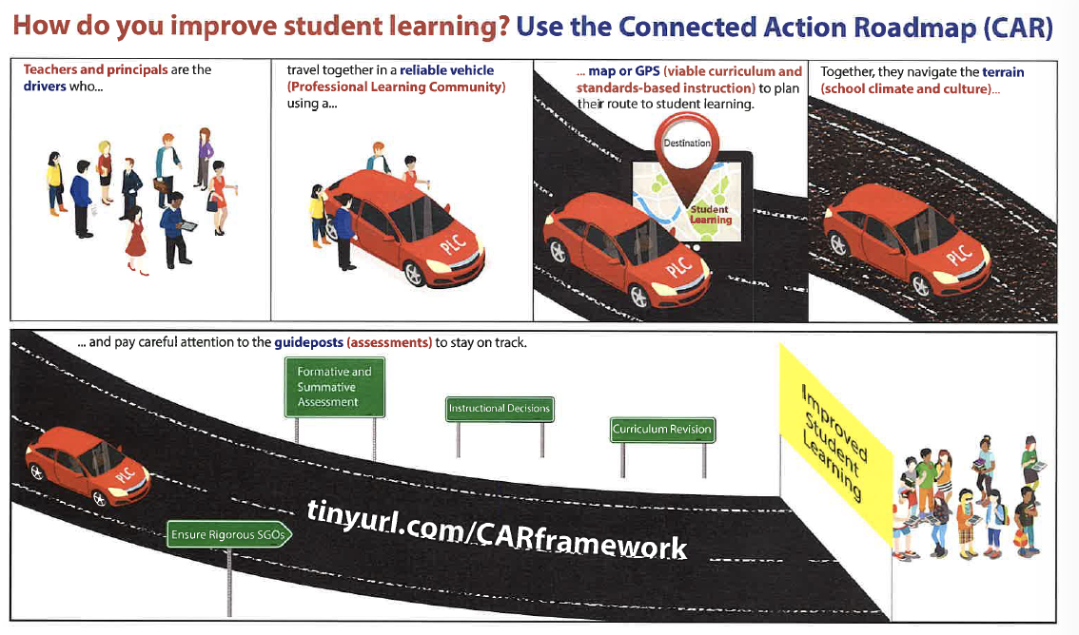
Connection Action Roadmap (CAR)
Notes:
Stephanie

Slide 23
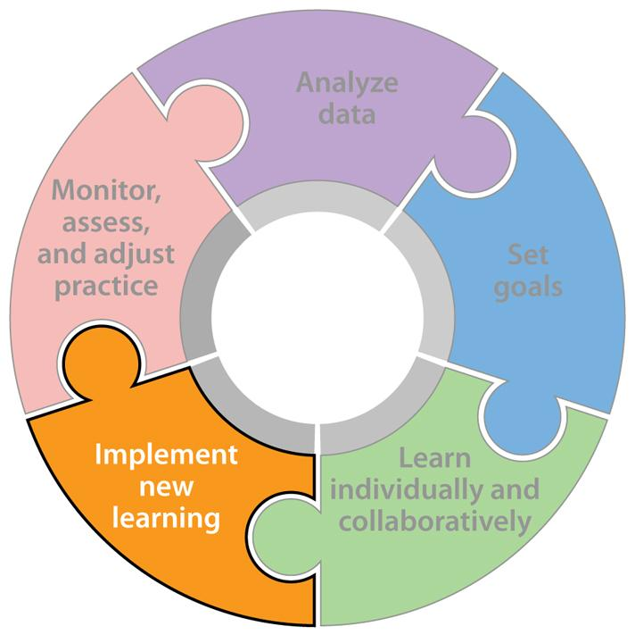

Implement new learning
In this stage....
Teams implement new learning with local
support in the classroom.
Notes:
John

Slide 24
Implement new learning
Key actions
Develop plan for instruction and use of new strategies
Implement new learning with local support in the classroom
Use tools or resources to guide implementation and support adaptation as necessary
Enlist job-embedded support
Engage in feedback process with evidence from others to inform continuous improvement

Slide 25
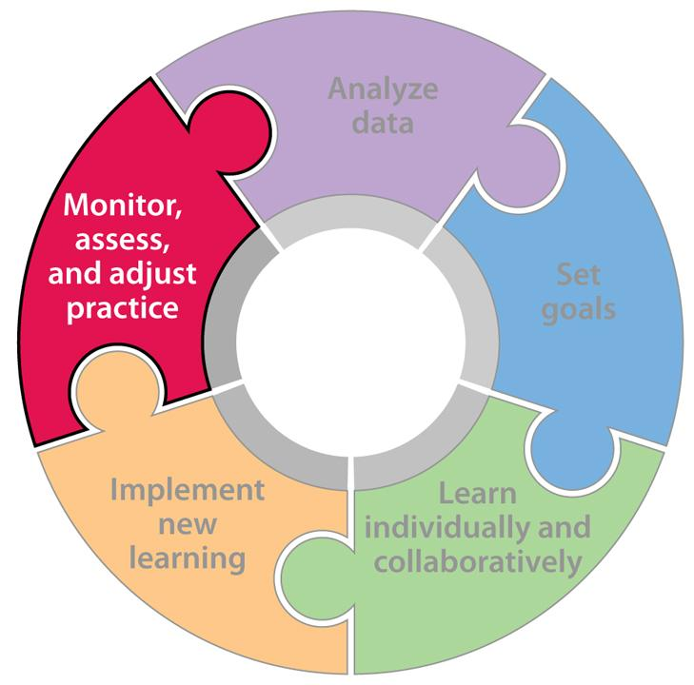

Monitor, assess, and adjust practice
In this stage....
Teams use evidence to assess and refine implementation and impact.
Notes:
John

Slide 26
Monitor, assess, and adjust practice
Key actions
Collect formative and summative data
Use evidence to assess and refine implementation and impact
Monitor progress toward goals
Analyze data and reflect on outcomes
Refine and determine next actions

Slide 27

Conditions for successful implementation
Vision and leadership
Time
Alignment and accountability
Clarity of team goals
Facilitation
Collaboration skills
Commitment to collective responsibility
Notes:
Stephanie

Slide 28
Call to Action
#1: Be intentional about collaboration and problem solving with colleagues
#2: Take the lead
#3: Build and strengthen learning teams

