Slide 1
On Our Plates: Food Insecurity Across the Economic Spectrum and its Impact on School Culture
Susan Barry
Co-chair, New Jersey County Teachers of the Year
Notes:
Good morning and thanks.

Slide 2
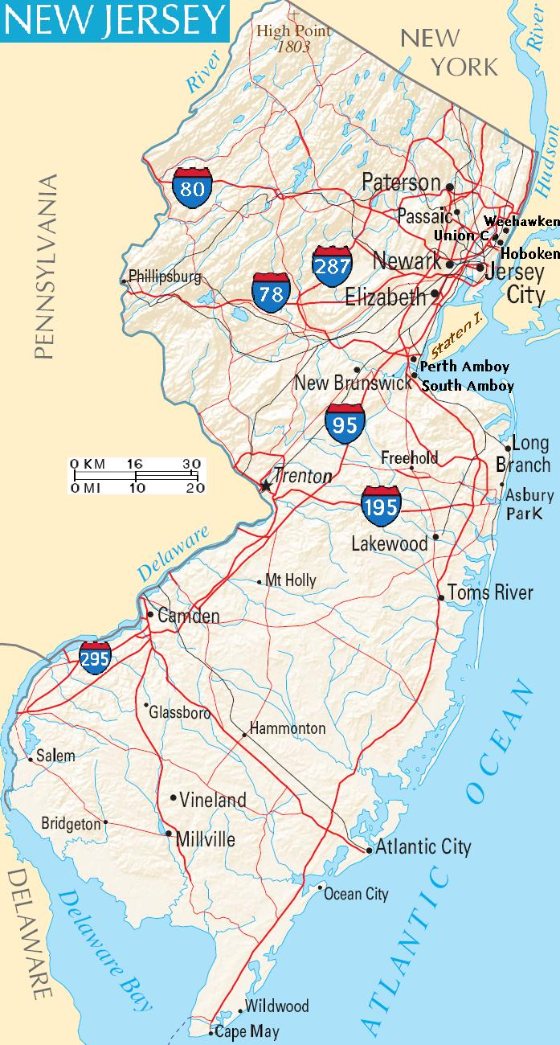
Relevance Guide
NJ focus
Intersectional look at food insecurity/low food security
Closer look: suburban/rural food insecurity

Slide 3
In an hour, you will have...
An increased understanding of causes of food insecurity and ways of seeing its effect on your school’s culture
“Look fors” to identify at-risk members of your school community.
A list of possible helpers
Some “next steps” that fit your classroom/building/district needs and culture
Notes:
Start out with Causes and Contexts for Food Insecurity.

Slide 4
On your own, take a minute to consider this question:
What is your experience with having enough to eat?
Notes:
Need everyone to stand up.
If you choose to participate...If, in the past year, you and your household members have had enough to eat on a regular basis, please come stand on this side of the room.
If in your lifetime, there has ever been insufficient food in your household, please step to this side of the room.
If, in your parents’ lifetimes, you are aware of times when they have not had enough to eat, please step over to this side of the room.
If, in your grandparents’ lifetimes, you are aware of times when they have not had enough to eat, please step over to this side of the room.
Think about how many people started on this side of the room, who identified as being secure in knowing where and when their next meal will happen.
What does it say that so many of you are standing on the other side of this room? (all are vulnerable, many of us have hunger in our memories within two generations)
Who in this room has at least one college degree? At least one advanced degree? So if you or your family have been vulnerable to hunger, what does that mean for your students? How about your colleagues?
Find someone you don’t know. Introduce yourself. Take two minutes to talk about your experiences of having enough food.
Would anyone like to share one point from your conversation?

Slide 5

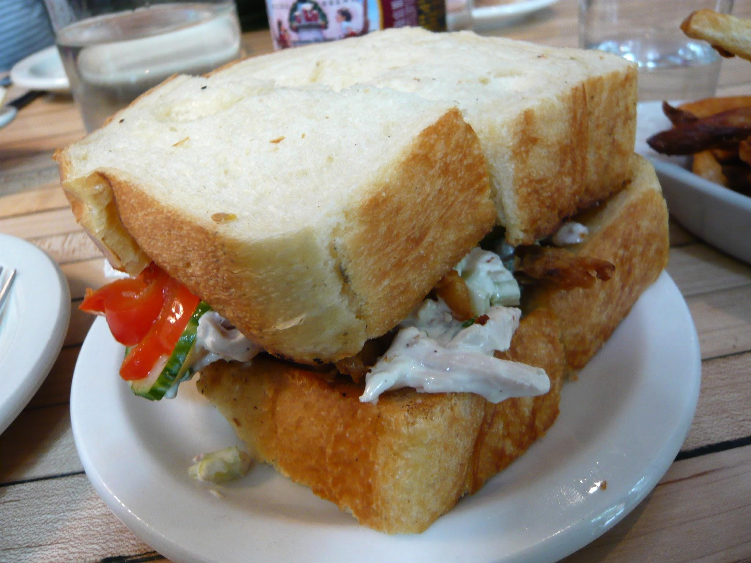
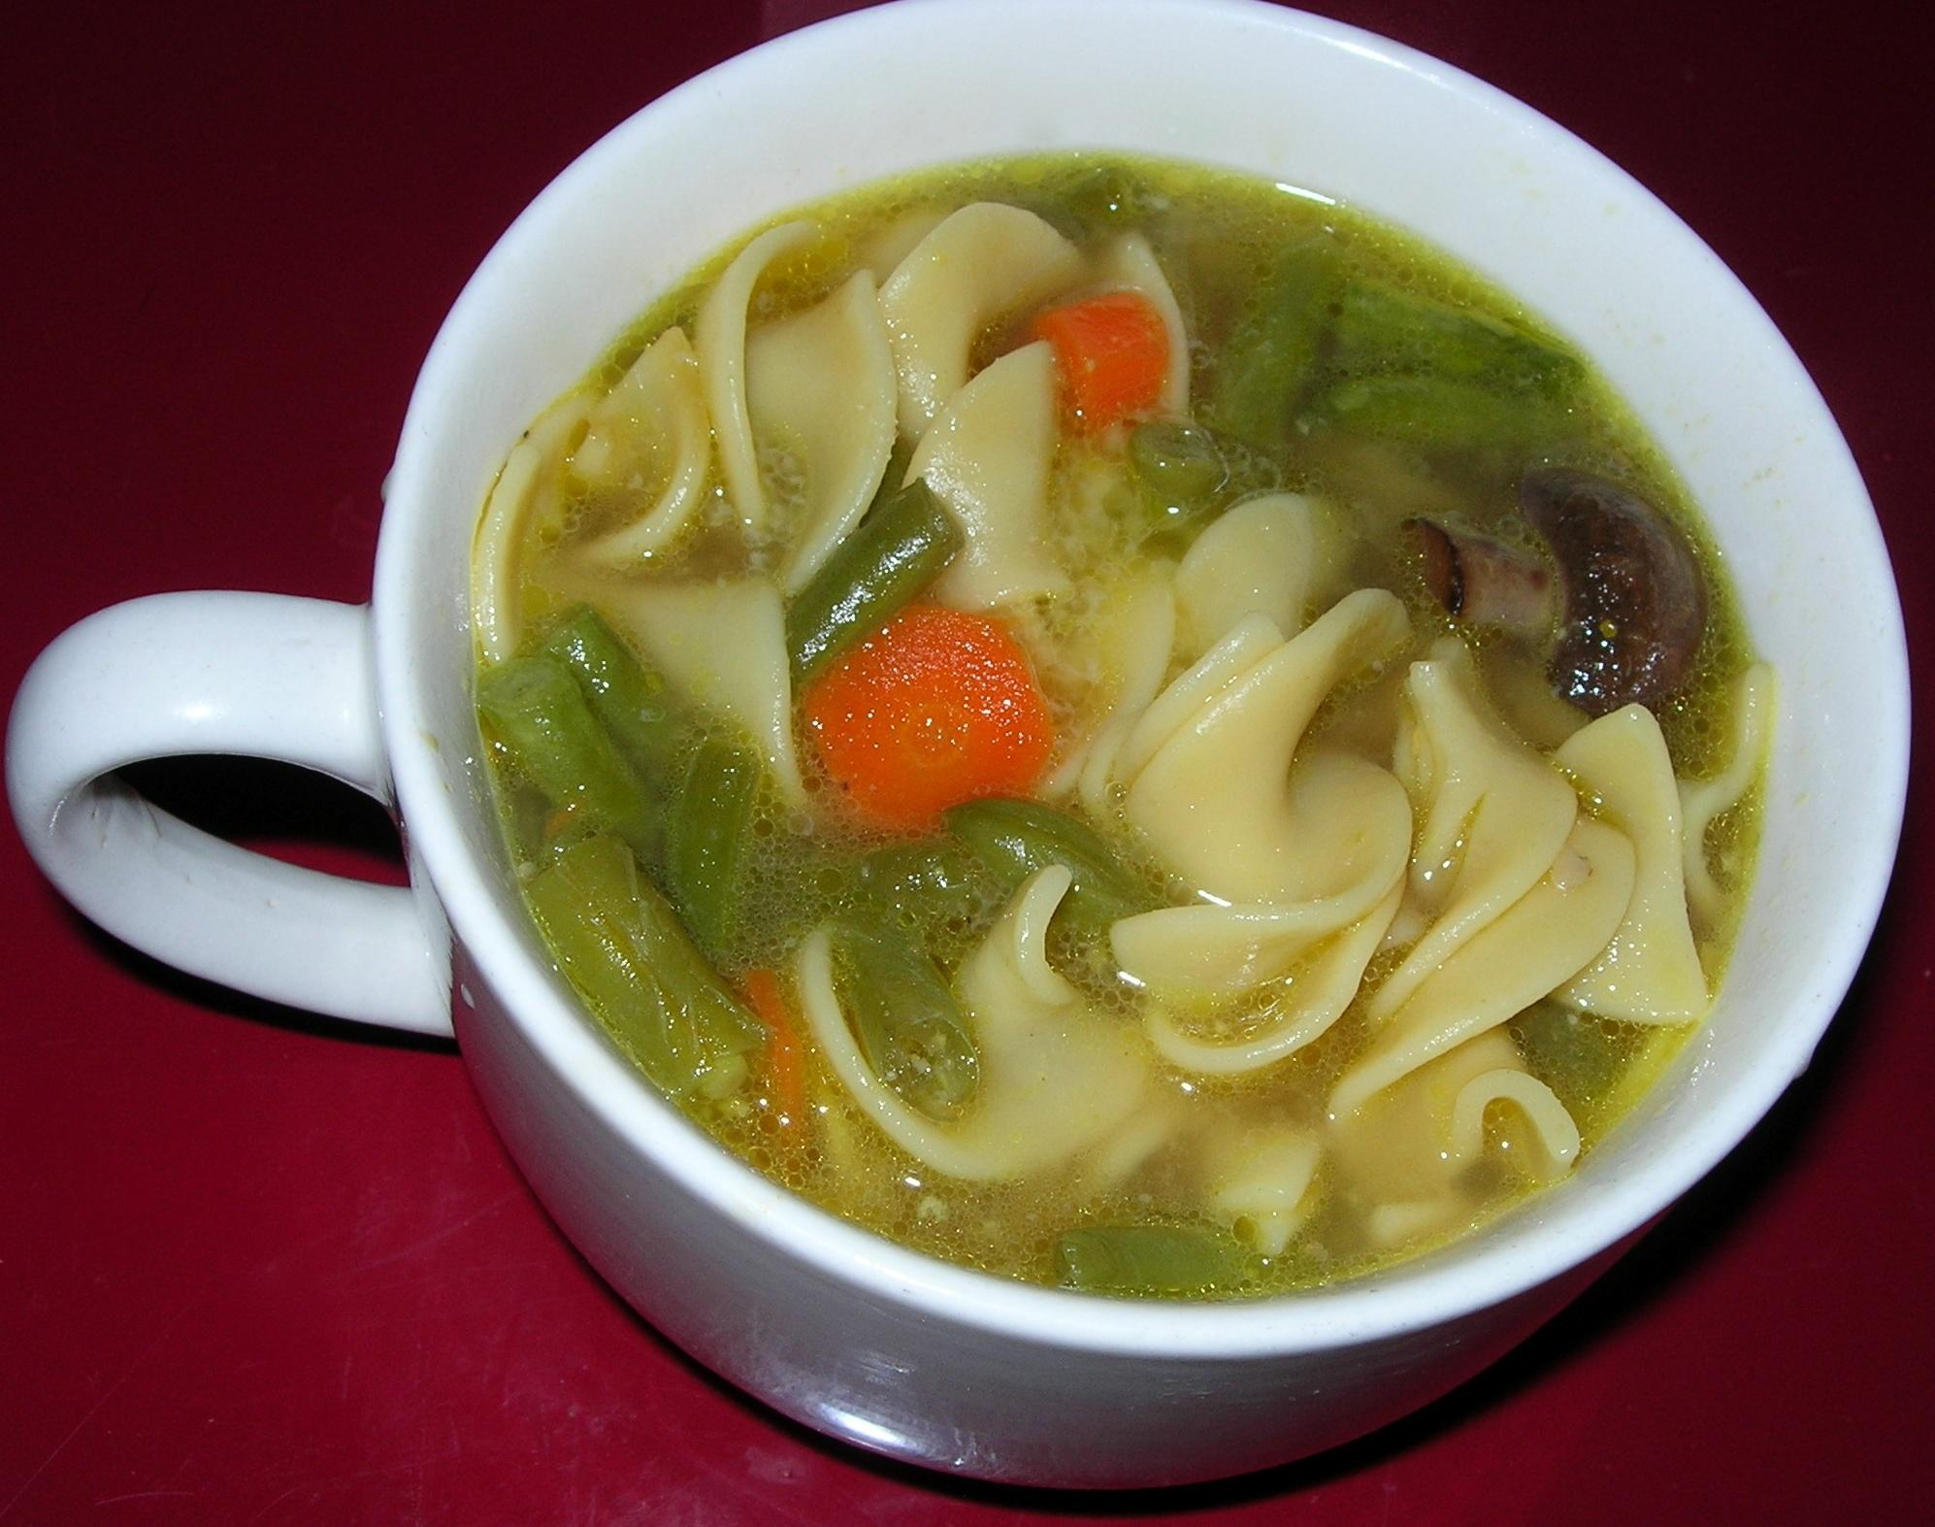
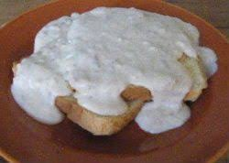
SUNDAY
MONDAY
TUESDAY
Roasted Chicken
Chicken Salad Sandwiches
Chicken Soup
WEDNESDAY
Gravy Bread
Notes:
Grandma Barry and chicken
Thursday through Saturday...that’s food insecurity.
With insecurity comes stress, anxiety, resentment, aggression...not learning. Not health.

Slide 6

Food Insecurity in New Jersey:
Causes and Contexts
Notes:
Poll the crowd…
If you work in New Jersey
If you teach
Student support staff (guidance, social work, food service, transportation)
If you are an admin or district leader
If you are part of a teacher training program
If you are with a government agency, foundation, or consulting firm

Slide 7
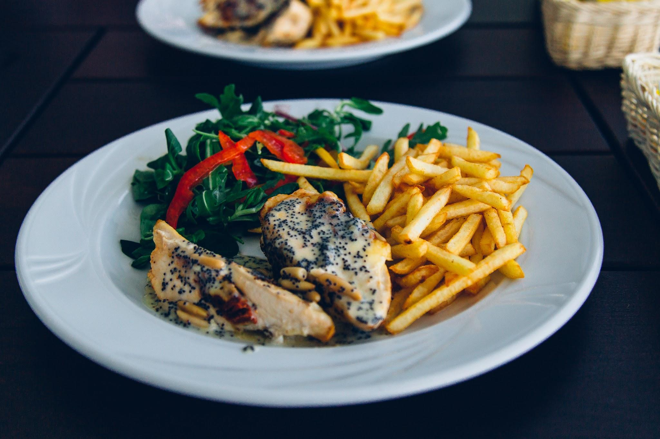
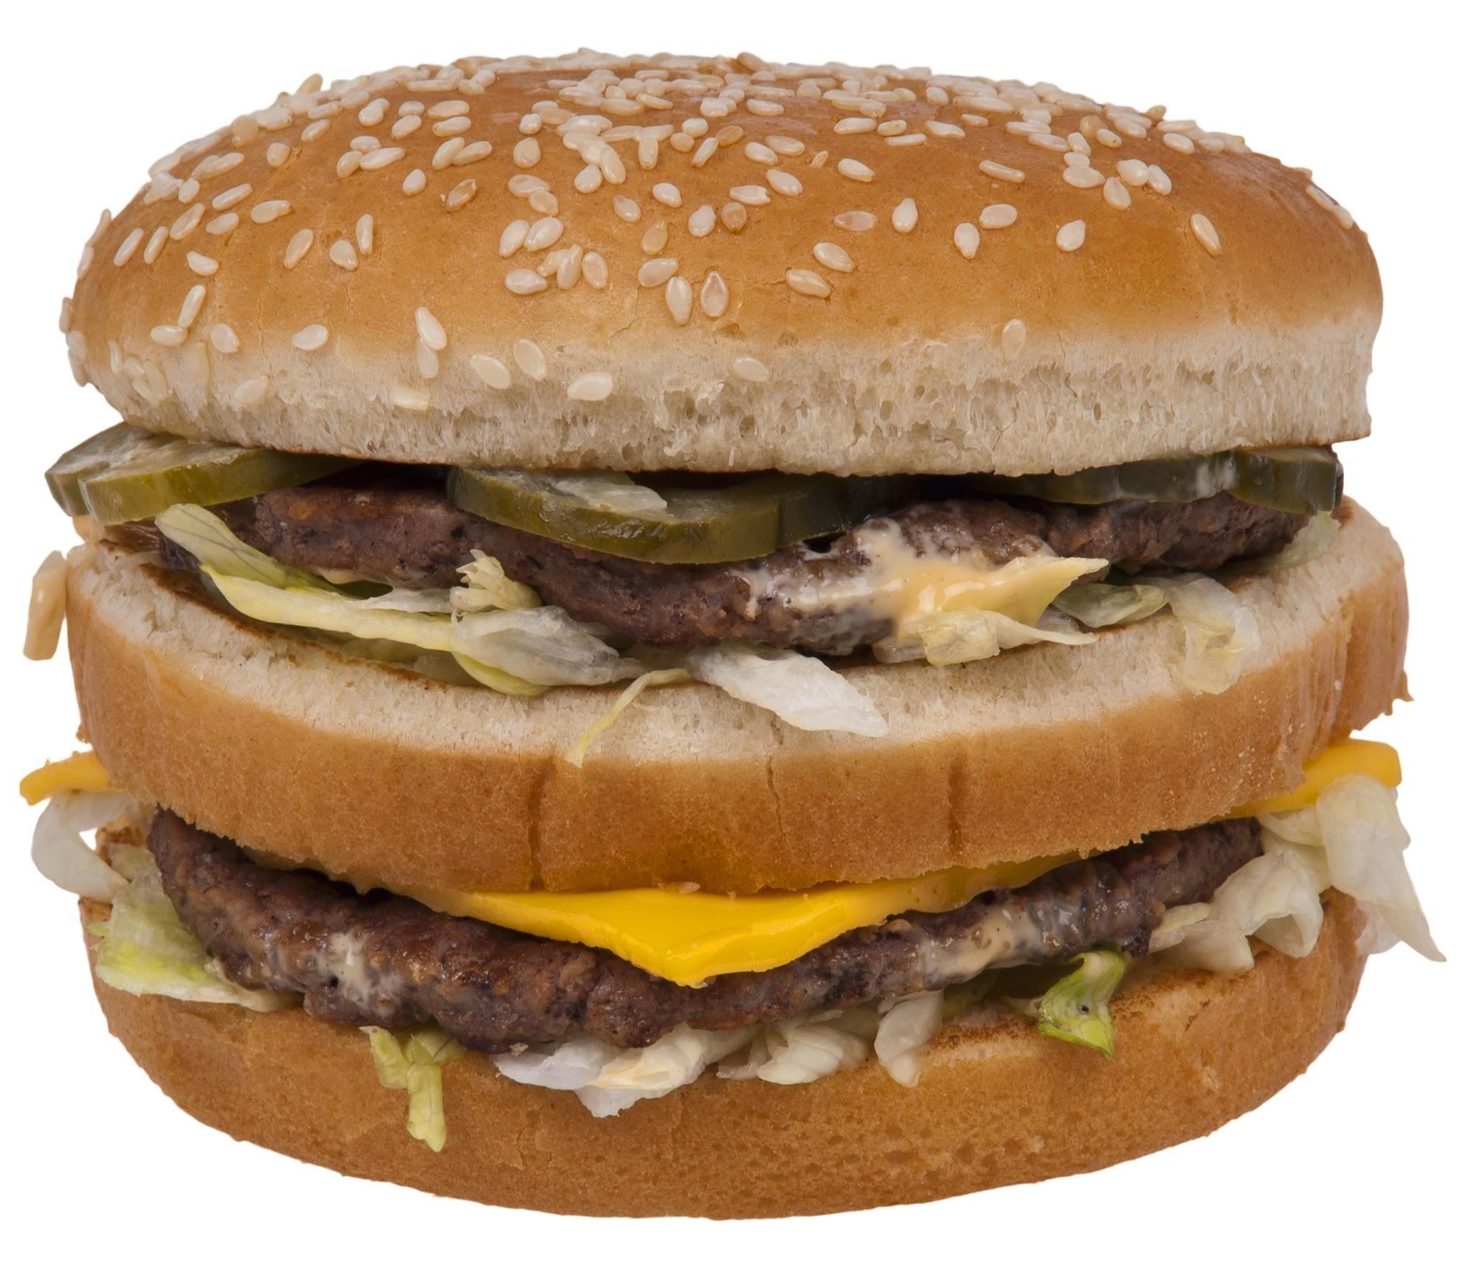
What exactly are we talking about?
Food security is defined as: access by all people at all times to enough food for an active, healthy life. (USDA)
OR
Notes:
Definition hinges on ALL, ENOUGH, ACTIVE, HEALTHY
Just because a food item goes into a child’s belly does not mean that it is a quality food item in sufficient quantities.
WHat are your kids eating OUTSIDE the cafeteria?

Slide 8
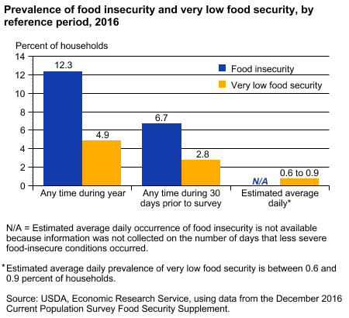
Food insecurity is situational, episodic, and occasioned by “a lack of available financial resources for food at the level of the household.” (Feeding America). Measured in daily, weekly, or monthly increments.
Notes:
Graph: USDA measures food insecurity as finite occurrences during the course of the year, as opposed to chronic, long-term hunger. ONLY MEASURES HOUSEHOLDS...NOT HOMELESSNESS. Use caution when looking at charts, graphs, and statistics; they may not be accounting for all food insecure students.

Slide 9
More specifically, from the USDA...
Low food security: reports of reduced quality, variety, or desirability of diet. Little or no indication of reduced food intake.
Very low food security: reports of multiple indications of disrupted eating patterns and reduced food intake.
Notes:
What do each of these designations look like in your students? Can we talk about the implications of ‘little to no indication of reduced food intake’? What signs can we look for?

Slide 10


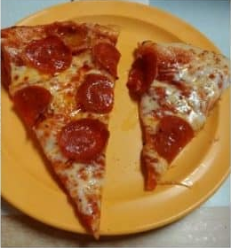

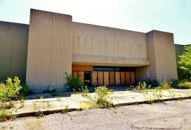



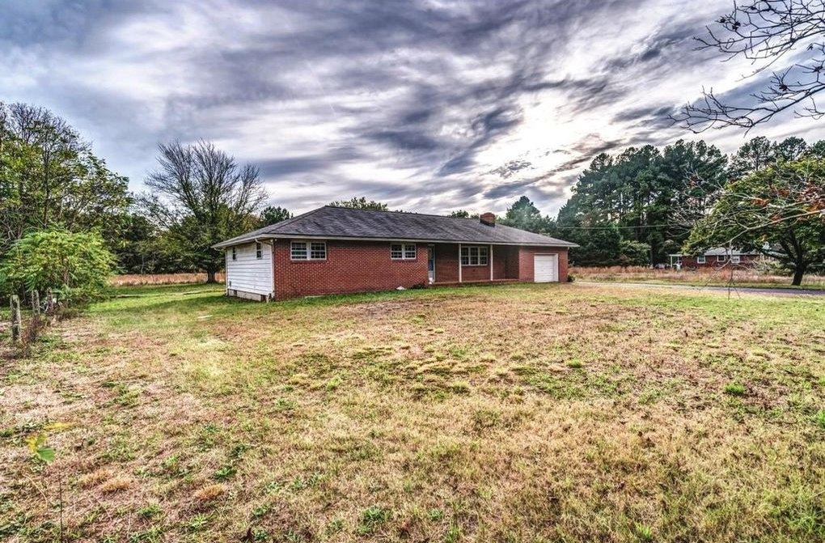

Causes of Food Insecurity
Notes:
In 2016, an estimated 1.3 million children in grades K-12 were homeless at some point. 700,000 were 13-17 years old.
Housing instability can contribute to situational food shortages, especially in situations of temporary homelessness, such “couch surfing,” shelter or transient living situations where cooking and food storage facilities are limited, and when family members are divided among more than one living situation. Homeless adolescents are particularly vulnerable to food insecurity because they aren’t often visible especially in suburban and rural areas.
Oftentimes food insecure families have a source of income, but the source has been limited because of layoffs, seasonal work shortages, or a change in employment status for one or more members of a family. Further, a 2012 study found that New Jersey is the 3rd most expensive housing market in the nation, requiring on average a $25/hour wage to afford a two-bedroom rental.
Accidents, injuries, and illnesses, especially those which result in lost work time, result in reduced income. Keep in mind that loss of parental supervision may also result, and children may be forced to fend for themselves in some situations.
Attached to injuries and illnesses are medical bills. When household budgets shrink because of medical bills, limited budgets must be rationed and reprioritized. Please be mindful of health care policies and how they might affect your students and their families. We’ll come back to the insurance issue in our next slide.
The loss of a job can be financially devastating to families, and the financial devastation is not always immediate. There may be some sustaining security measures in place to give the appearance of things being “OK.” Over time, those security measures may erode, while at the same time, we may have forgotten that the family is in need. Hunger is not limited to November and December, but that is when most food is donated and distributed.
Food insecurity increases dramatically among low-wage earners, as well as those on fixed incomes. Keep in mind that in New Jersey, 36% of people who report being food insecurity DO NOT QUALIFY FOR FOOD ASSISTANCE.
Social Isolation is often an indicator of food insecurity. Consider some characteristics of households that are at risk for food insecurity: those lead by single parents, households in which children are being raised by elderly caretakers or grandparents, economically disadvantaged families in transient housing situations. We’re talking about people who don’t necessarily have social support networks to assist with childcare, money, and food resources.
Geographic isolation: talk about rural/suburban New Jersey. Common to see pockets of poverty in the most affluent of districts because of “education flight.” Are funds being rationed between housing, food, and other needs? Public transit? Walking distance?
Food deserts. Where’s your nearest supermarket? Can you walk there? Do you work in an area where there are supermarkets with fresh produce and protein? What are your students’ healthy food options?
Household food rationing: are parents and older children foregoing food so certain household members can eat?

Slide 11
Other considerations...
USDA (2016): Poverty threshold for 1 adult/2 child household: $19,337. SNAP Benefit eligibility income is $37,296.
Harvard School of Public Health (2017): “There are 16.9 million Americans living in poverty in the suburbs - more than in cities or rural communities...40% of the uninsured population live in the suburbs.”
Community Food Bank of New Jersey (2016): 16.8% of children are food insecure.
Notes:
Working families, even if they are underemployed, often do not breach that threshold and therefore do not qualify for government safety-net services.
This presentation is not meant to minimize poverty and hunger in urban areas. That poverty is highly visible. But there is often infrastructure in place in urban areas to serve kids with food needs: free breakfast, lunch, and dinner programs; community centers; governmental services focused specifically on community needs. My point here is that we’re seeing drastic increases in the rates of suburban and rural poverty in New Jersey.
Community Food Bank of New Jersey reports that 16.8% of New Jersey’s children are food insecure, and many of these children are invisible because, conventionally, we didn’t think to look for them in the suburbs and rural pockets of the state. We have to stop thinking that, because they’re showing outward signs of health and growth, our kids are getting enough to eat.

Slide 12
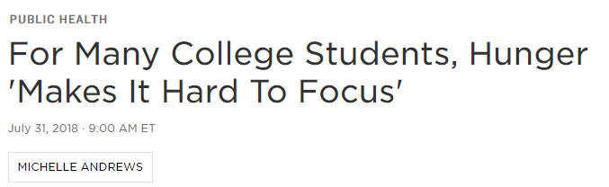


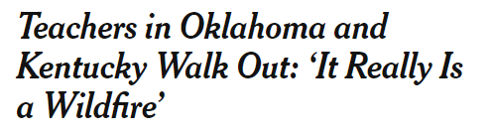
Who Are We Missing in the School Community?
National Public Radio, 7/31/18
New York Times, 4/2/18
Notes:
Who aren’t we considering when we think about food insecurity in our schools?
Certificated staff and paraprofessionals
Student teachers
School support staff

Slide 13
Food Insecurity in New Jersey:
What Can We Look For?
“If one person in eight starves regularly in the world, this is… the result of his inability to establish entitlement to enough food; the question of the physical availability of the food is not directly involved.”
-Amartya Sen,
1998 Nobel Laureate, Economics
Poverty and Famines: An Essay on Entitlement and Deprivation
Notes:
Famine happens in the presence of food because the hungry do not have sufficient resources to get it.

Slide 14
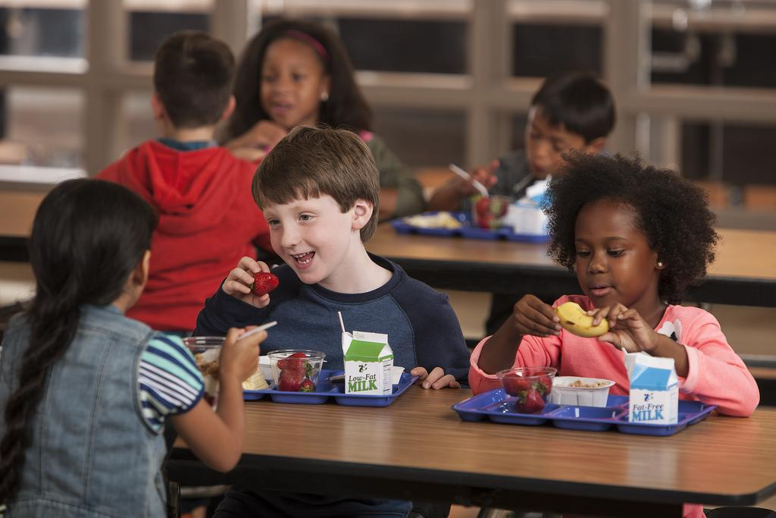
Think About Your Students and School Community Members...
What signs would indicate to you that a person in your educational setting is food insecure? Choose a thought partner or two in your area and jot down some “look fors.”
You have 5 minutes.
Be ready to share two to three ideas!

Slide 15
Is the community member...
Anxious for the next meal to be served?
Lingering for a second helping or more?
Exhibiting extreme hunger on Mondays or returns from breaks?
Exhibiting fatigue, short attention span, inability to concentrate?
Snacking whenever possible, or asking for snacks?
Taking extra food “for later” when it is available?
Montana Food Bank Network

Slide 16
When It’s Time to Have a Conversation About Food...
Make sure it’s happening between people who trust each other.
It must be coming from a place of concern and a desire for healing or growth.
It might not be explicitly about food, but you must be sensitive to any indicators of food insecurity.
Notes:
If not you, then find someone who the student/community member DOES trust.
Instead of taking an approach that signals that there is a problem (“You’re late again and I need to know why!”), take an approach that says, “I’m concerned about YOU.”
Food insecure people reveal few or no signs of reduced food intake. You are doing subtle detective work when you suspect a member of your school community is food insecure.

Slide 17
Some One-on-One Conversation Starters...
“How have you been feeling lately?”
“Tell me about the people in your house.”
“Did you eat breakfast?”
“What time do you wake up in the morning/go to bed at night?”
“What are your plans after school?”

Slide 18
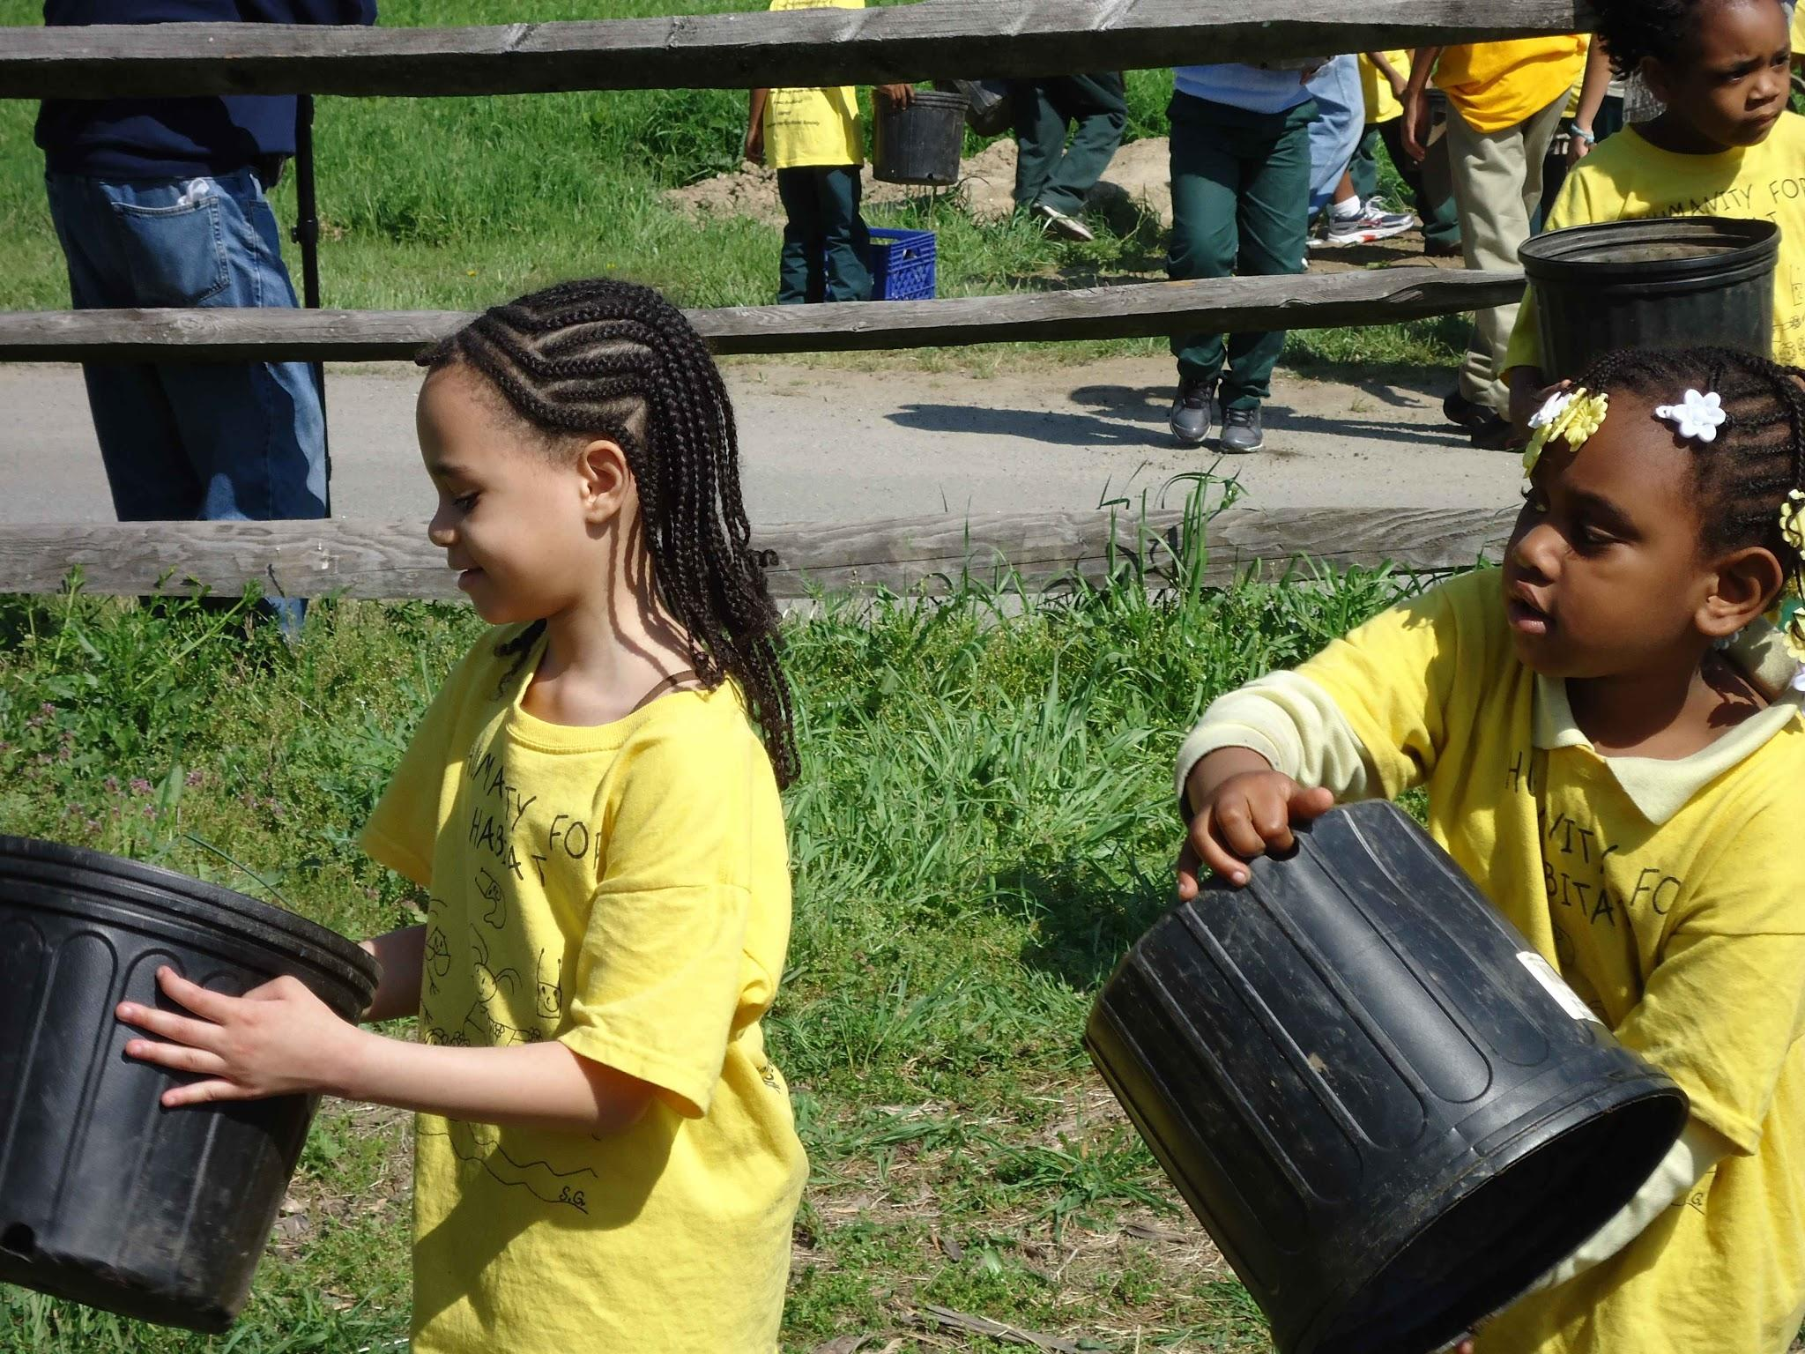
Food Insecurity in New Jersey:
Finding The Helpers

Slide 19

“It all starts with seeds.” -Stephen Ritz
You can’t do this alone.
You are not the only person who sees this student or colleague during the day.
Photo: Earth911.com
Somewhere, there are people who want the same thing.

Slide 20
Who Are The Helpers?
Take a moment to think…
Who are the obvious helpers? Who are the hidden helpers?
Let the “Look Fors” guide your thinking.
Jot some ideas either by yourself or with a thought partner.
You have 5 minutes. We would love to hear three ideas.

Slide 21

Food Insecurity in New Jersey:
Next Steps for September

Slide 22
Some Steps Other Districts Have Taken...
Establishing food pantries and backpack programs
Providing confidential assistance with free and reduced-price lunch forms to meet the parent’s/guardian’s needs
Establishing shared food culture between staff members (Friday Soup Club)

Slide 23
Some Steps Other Districts Have Taken...
Establishing “Breakfast After the Bell” programs and other best practices.
Maximizing communication between student support staff: school nurses, social workers, guidance counselors, coaches, physical trainers, cafeteria staff, etc.
After-school “food clubs” that teach students about healthy, economical cooking, eating, and food production.

Slide 24

Get in touch!
sbarry3373@gmail.com
Twitter: @MsBarry_GCTOY

